Slide 1


Helpful Resources for
Undergraduate Research

Slide 2
Common Myths and Misunderstandings
Prior experience is needed to get a research position
  MYTH
  Most students join a lab with little to no experience – even some graduate students start research without having had prior lab experience. It is just important to show dedication and attentiveness.
If I don’t hear anything from the professor, then that means I did not get the position
  MYTH
  Professors are very busy, and emails usually get buried – Reach out to the professor again after 2 weeks if you have not heard back from him/her
Its better to reach out to a professor when you are an upperclassman
  MYTH
  Though you want to wait until you feel comfortable with your class load and extracurriculars, its never too early to reach out. Also, conversely it is never too late. If you find research that piques your interest, reach out to the professor for a meeting.
Students should choose research in their major.
  MYTH
  Don’t limit your search for research to your major. There are many interdisciplinary and collaborative work going on across the UW. Find something that makes you curious and don’t be afraid to go outside your comfort zone.

Slide 3
Helpful Resources
URP website
  https://www.washington.edu/undergradresearch/students/find/
UW Libraries
  https://canvas.uw.edu/courses/1388650
Scholarships and Funding Opportunities
  Mary Gates Scholarship
  Washington Research Foundation Fellowships
  https://www.washington.edu/undergradresearch/students/funding/
REU experiences https://www.washington.edu/undergradresearch/summer/summer-beyond-uw/
  https://www.cei.washington.edu/education/undergraduate-students/reu/
  https://uwmemc.org/education/programs/reu/
Research Opportunities
  Institute for Protein Design
    https://www.ipd.uw.edu/join-us/
  https://new.expo.uw.edu/expo/login

Slide 4
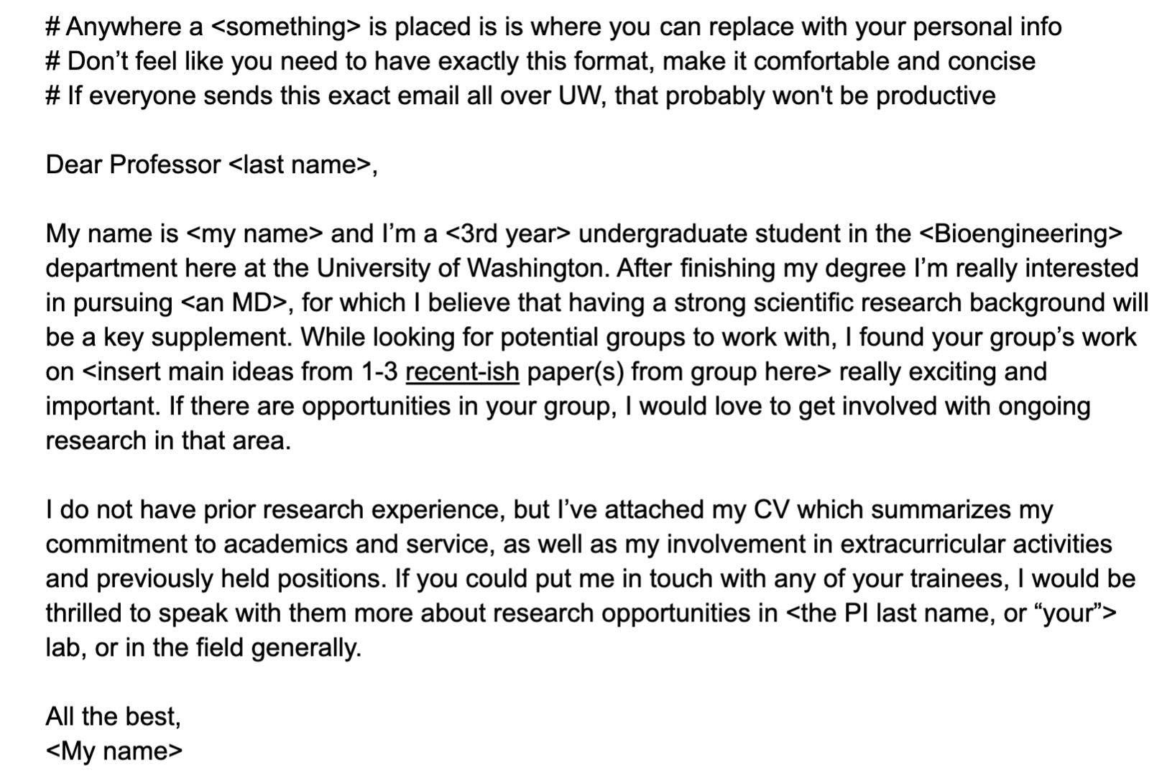
Example email template

Slide 5
Contacts
Feel free to contact us with any questions!
MolES Outreach Chair: Phuong Nguyen: nguyennp@uw.edu
Panelists:
  Bonni Leeds: bkleeds@uw.edu
  Evan Pepper: epepper@uw.edu
  Jimmy Ye: zimingye@uw.edu
  Pranav Sarda: sarda@uw.edu
  Serag Sorror: serags@uw.edu

